Slide 1
Superlative
comparative
Superlative
Comparative
Superlative
100
100
100
100
100
200
200
200
200
200
300
300
300
300
300
400
400
400
400
400
500
500
500
500
500
Notes:
Instructions:
On the menu write your own categories in the headings provided
For each question simply change the text in the Question and Answer text boxes. When the slide is in full screen mode neither can be seen until the two blue buttons are pressed. In this way you can choose to give either the question or the answer first.
You can place pictures between the Question and Answer but you must make sure that you ‘Entrance’ it with Custom Animation and place this entrance command as part of the ‘trigger’ for Question or Answer
To return to the main menu, click the menu button
To move to the next question, click the numbered button at the top right and this will take you there without going to the menu.

Slide 2
superlative
100
I always tell the _________ (fun) jokes.
funniest
Question
Answer

Slide 3
superlative
200
He is more popular / the most popular
singer in the world.
Question
Answer

Slide 4
superlative
300
-My hair is the straightest / straighter
than your hair.
Question
Answer

Slide 5
superlative
400
Who is the best / better than singer in the world?
Question
Answer

Slide 6
superlative
500
My brother is taller than / the tallest in the class.
Question
Answer

Slide 7
Make Sentences
100
taller / than / Gary / Rick / is.
Gary is taller than Rick.
Question
Answer

Slide 8
Make sentences
200
Comics are _____________ (funny) History books.
Funnier than
Question
Answer

Slide 9
Make Sentences
300
Vegetables are _______________ (healthy) hamburgers.
Healthier than
Question
Answer

Slide 10
Make sentences
400
Cars are __________________
(expensive) bicycles.
more expensive than
Question
Answer

Slide 11
Make sentences
500
Football is ________________
(popular) volleyball.
more popular than
Question
Answer

Slide 12
Superlative
100
Who is shorter than / the shortest person
in your family?
The shortest
Question
Answer

Slide 13
Superlative
200
-Lara is a very pretty girl.
-She is _________________I know.
The prettiest girl
Question
Answer

Slide 14
Superlative
300
My cousin is very tall.
He is _________________ I have.
The tallest cousin
Question
Answer

Slide 15
Superlative
400
-This house is very big.
- It is __________________
I’ve lived in.
The biggest house
Question
Answer

Slide 16
Superlative
500
-He’s a very boring person.
-He’s _____________________
I know.
The most boring person
Question
Answer

Slide 17
Comparative
100
Spain is much ______________ Germany.
hotter
Question
Answer

Slide 18
Comparative
200
Cars are _______________ motorbikes.
Safer than
Question
Answer

Slide 19
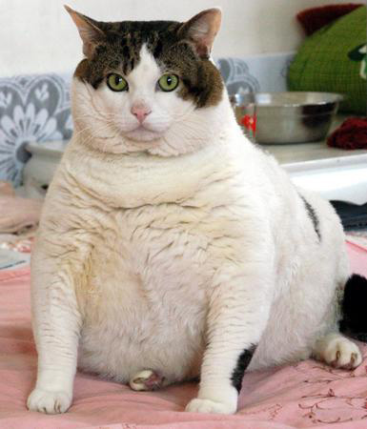
Comparative
300
I am _______________ you.
fatter
Question
Answer

Slide 20
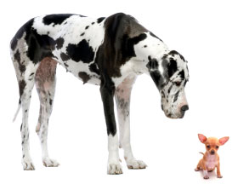
Comparative
400
My bedroom is _______________ yours.
Bigger than
Question
Answer

Slide 21
Comparative
500
Surfing is __________________than tennis.
More dangerous
Question
Answer

Slide 22
Superlative
100
She’s a popular singer.
She’s ________________________
in the country.
The most popular singer
Question
Answer

Slide 23
Superlative
200
It was a very cold day.
It was ______________ of the year.
The coldest day
Question
Answer

Slide 24
Superlative
300
It was a very bad mistake.
It was __________ mistake I made.
The worst
Question
Answer

Slide 25
Superlative
400
It’s a very good film.
It’s_____________ I’ve seen.
The best film
Question
Answer

Slide 26
Superlative
500
It was a very happy day.
It was _______________ of my life.
The happiest day
Question
Answer

